Slide 1
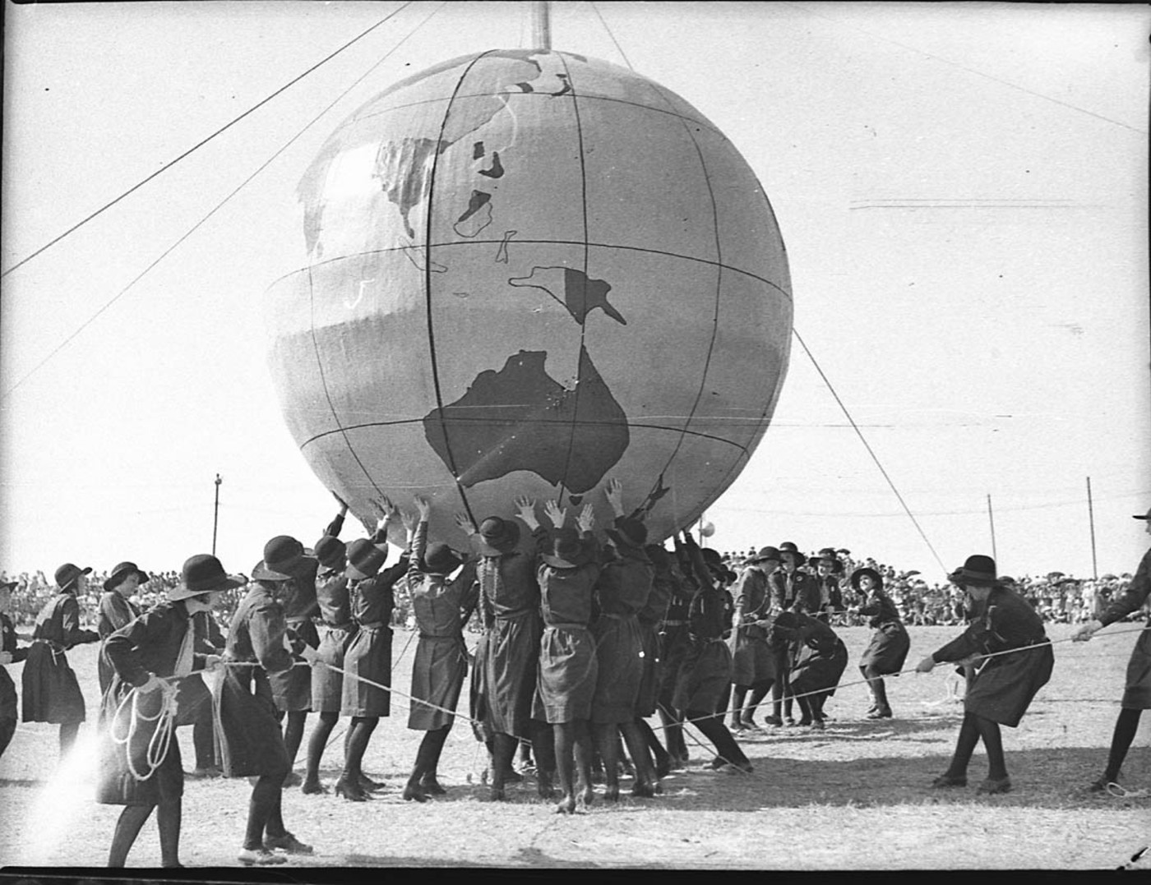
A collaborative effort
Notes:
A bit about process and why digital scholarship – interested in the impact on principally, staff and services and how the changes – disruptive or emancipatory are shaping the future of academic libraries and librarians

Slide 2
Context
What is digital scholarship?
Recurring characteristics
Open(ness)
values
ideology
content
Network(ed) participation
peer to peer
outreach
public facing
Digitization of content
curation
access

Slide 3
Survey
20 institutions from UK & Ireland
Adapted approach used in US by Vinopal and McCormick (2013)
Assessment of the role of the Library
Levels of preparedness
Previous practice
Seizing new opportunities for collaboration and partnership
Leadership

Slide 4
It’s the people not the technology
Stability
Building on our core values
Being trusted and valued
Delivering on expectations
Being professional
Offering a neutral ( safe) space

Slide 5
Flexibility
Being “in the flow”
Adapting to changes in expectation at all levels – personal, service, institution and professional
Ability to acknowledge and act on changes in the working environment

Slide 6
Stretch
Willingness to take risk
Identify roles and opportunities to stretch and develop
Prepared to take a significant step-change
Focus on future gains
Acknowledge legacy and move on…
Become ‘digitally resilient’

Slide 7
Success criteria
My observations
It’s not about technology
It is about…..
Engagement
Outreach
Networking
Partnerships
Collaborations
Risk taking
Being opportunist
And…….

